Slide 3
Main Narrative
We unleash Tech.
Source Code:
We combine tech with customer needs bringing into life sustainable A class solutions both for business and society.
We lead the digital transformation of retail, with solutions that allow organisations to reimagine processes, integrate technologies and introduce innovative services to stay ahead in the market.
As part of the Public Group ecosystem, Public Next combines best-of-breed technologies with innovative ideas to create synergies that bring additional value to organisations and their customers.
Our main motto is “We unleash Tech that shapes the future of Retailing”.

Slide 4
Our Values
We Believe in:
Innovation
Growth
Open Minded
Engineering with Trust and Value for our Customers & Society
Never stop evolving, enjoying the journey and learn
Inclusion and advanced equality

Slide 5
State of Mind
As one team we are reimagining retail and introducing new capabilities that empower people and address changing customer needs.
We work side-by-side with our clients to ideate, rapidly prototype, and scale innovative products and services for the digital economy.
Omnichannel tools, personalization, fast and reliable order fulfilment, data insights and digital tools for a superior employee and customer experience are our main cutting-edge experiments.
We bring together the world-class tech talent and latest thinking from our dynamic ecosystem, universities, and industry leaders. The result is an immersive environment where you can reimagine your business in this challenging and fast forward omnichannel retail industry.

Slide 6
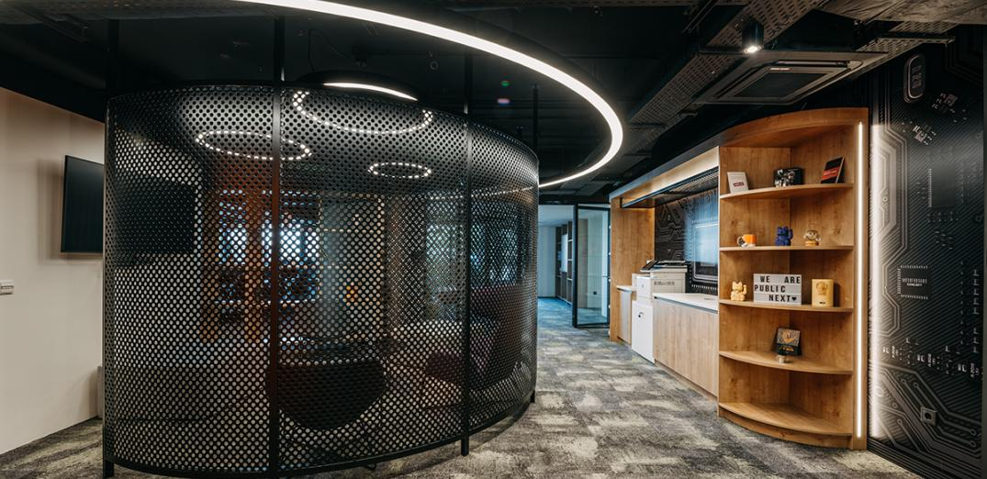
The ultra-modern,
state-of-the-art hub - 700 sq. m. within the Public Group’s HQ brings together information technology, digital and software development experts under one roof.
Physical Metaverse

Slide 7
Our Playbook
Communications Channels
Press Office
SoMe
Roadshow
Press Releases
Interviews
Speeches
Blog Articles
Activate Linkedin Page
Being part of the Community
Visits to Universities and Institutions
People
Multimedia
Career Path Initiatives
Volunteerism
Hackathon
Create video content showcasing:
Case Studies
Way of Working / Culture
Initiatives

Slide 8
We are passionate to digitise our ideas and be part of the retail evolution.

