Slide 1
Algosystems Explained
www.algosystems.gr

Slide 2
Algosystems at a glance
Networking
Cybersecurity
Systems and Data Center
Cloud Transformation
Collaboration
SOC & NOC - 24/7
Software Engineering -DevOps
Metrology
Automation
www.algosystems.gr

Slide 3
Vendors
Clients
www.algosystems.gr

Slide 4
OUR SUCCESS
TRUST
TEAMWORK
OPENNESS
OUR TEAM
EQUALITY
OUR PEOPLE
YOU?
COMMUMICATION
FRIENDLINESS
RECOGNITION
TRANSPARENCY
www.algosystems.gr

Slide 5
YOUR SUCCESS
CONTINUOUS TRAINING
EQUAL OPPORTUNITIES
CERTIFICATIONS
DEVELOPMENT
www.algosystems.gr

Slide 6
Our secret for a Happy Workplace!
www.algosystems.gr

Slide 7
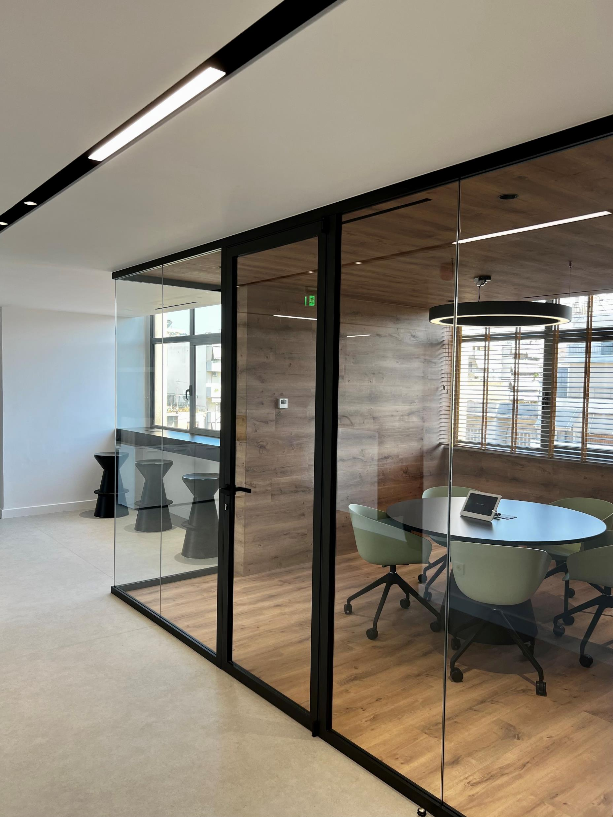
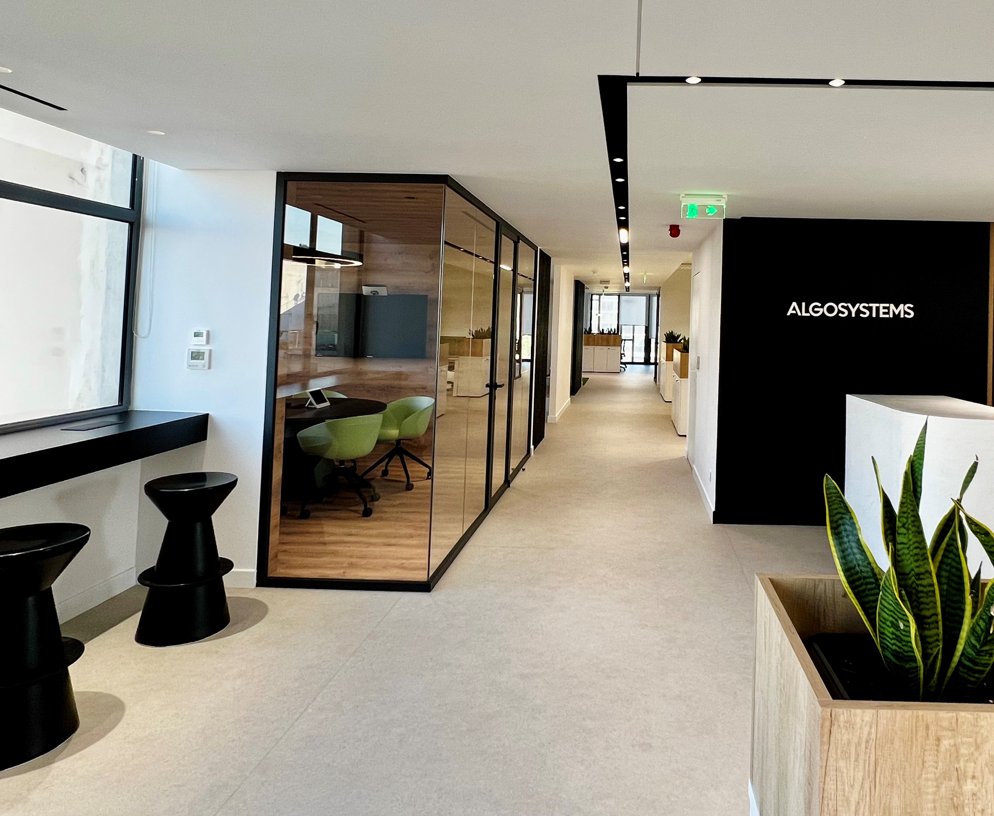
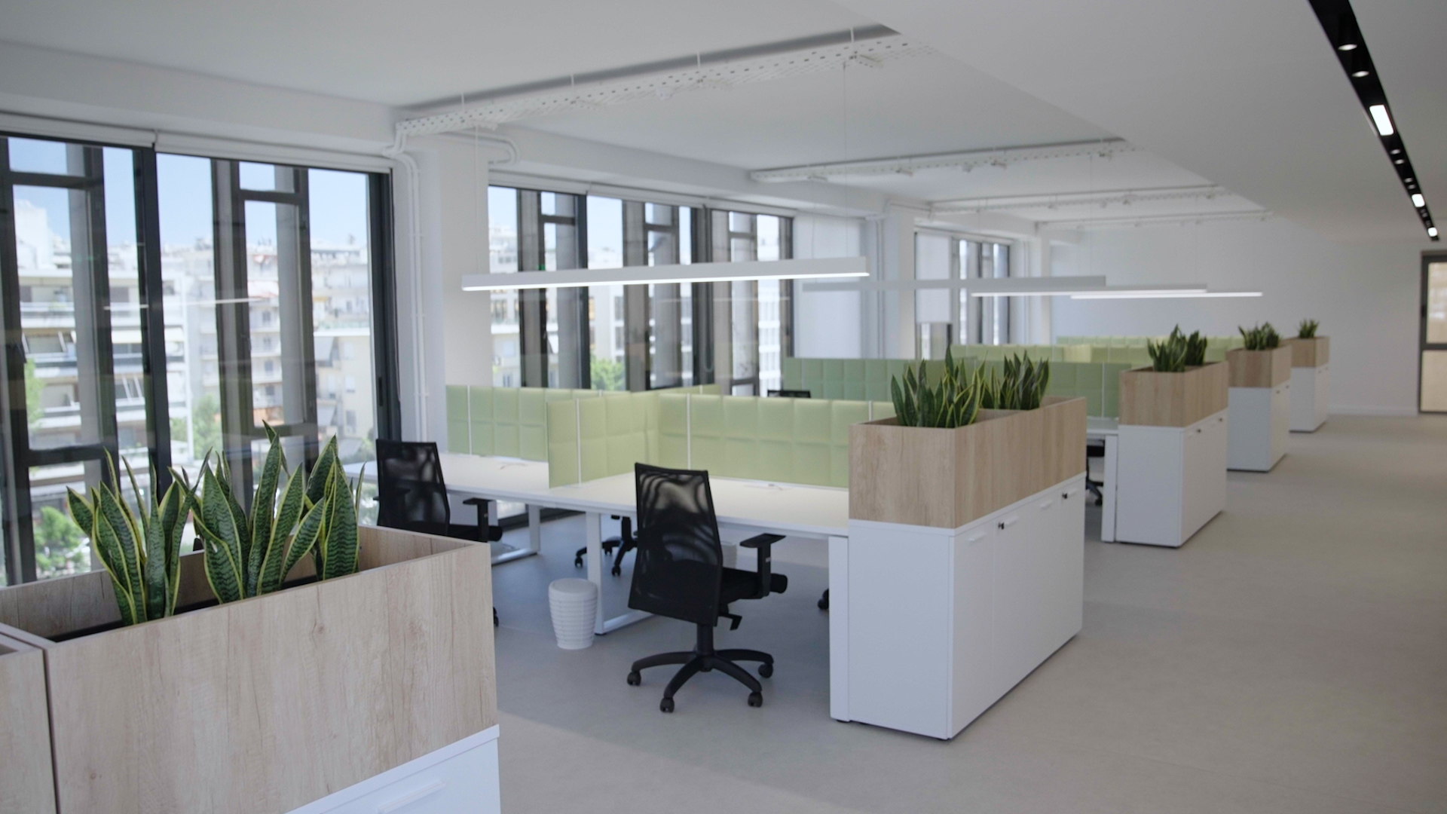
Cool Offices
www.algosystems.gr
www.algosystems.gr

Slide 8
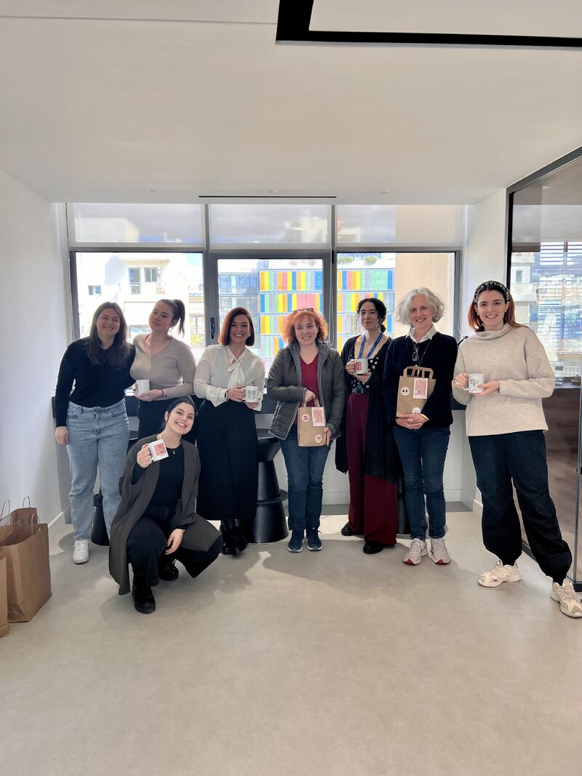
We share some #AlgoVibes
#International Women's Day
#SummerDream
#Development
#Algoversaries
#ThingsToDo-Visit
#Celebrations
#TeamBondingActivities
#SecretSanta
www.algosystems.gr

Slide 9
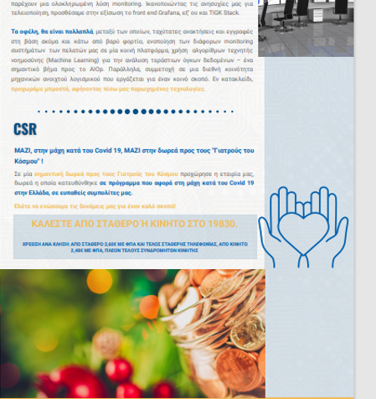
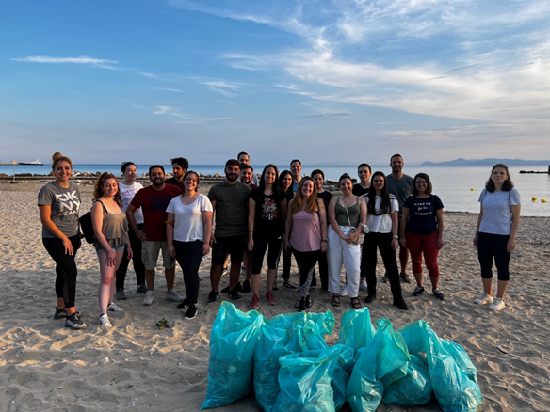
We love to give back
#Health
#BeachCleanUp
#XamogeloPaidiou
#ClothesDonation
#RaceForTheCure
www.algosystems.gr

Slide 10
Ready for the
ALGOTEAM EXPERIENCE?
Stay tuned for our news on
Say hello at hr@algosystems.gr

Slide 11
Ready for the
ALGOTEAM EXPERIENCE?
Network Eng.
NOC Eng.
Service Desk Eng.
SOC Analyst
Say hello at hr@algosystems.gr!

